Slide 1
Topic-Aware Evidence Reasoning and Stance-Aware Aggregation for Fact Verification
Jiasheng Siy , Deyu Zhou , Tongzhe Li , Xingyu Shi , Yulan He
School of Computer Science and Engineering, Key Laboratory of Computer Network
and Information Integration, Ministry of Education, Southeast University, China
Department of Computer Science, University of Warwick, UK
ACL 2021
Zhuomin Chen
2021.11.01

Slide 2
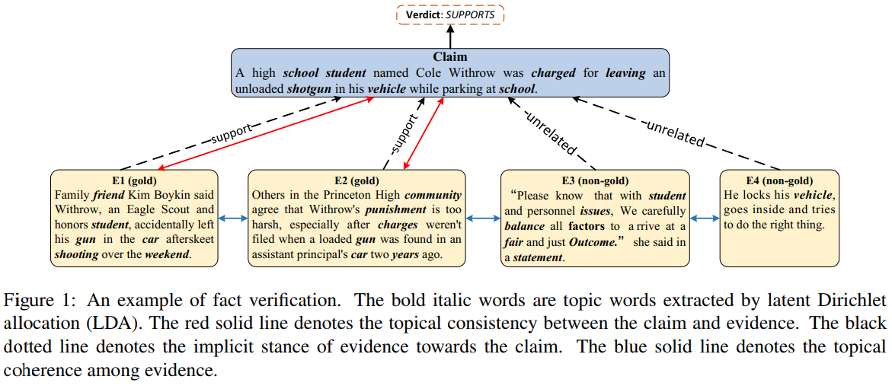
Introduction

Slide 3
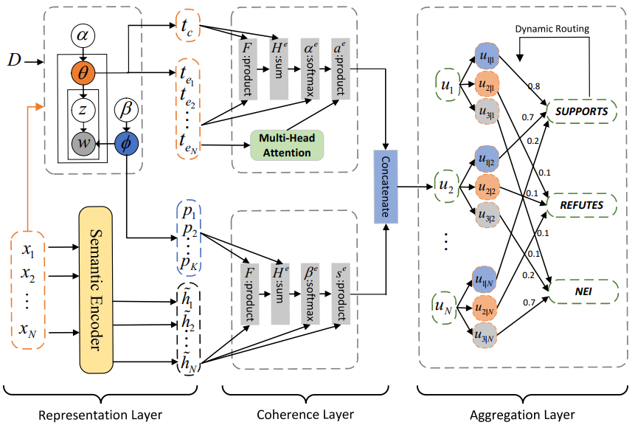
Method

Slide 4
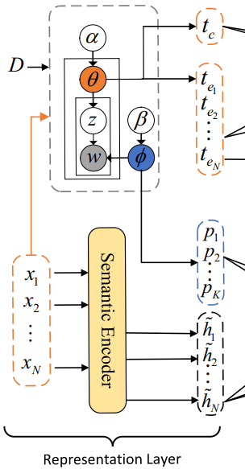






Representation Layer
Each claim paired with pieces of retrieved evidence sentences
Node:
Vanilla transformer:
The eXtra hop attention:
The semantic representation of evidence:

Slide 5





Representation Layer
Latent Dirichlet Allocation
Sentence-level topic representation:
Global topic information:

Slide 6
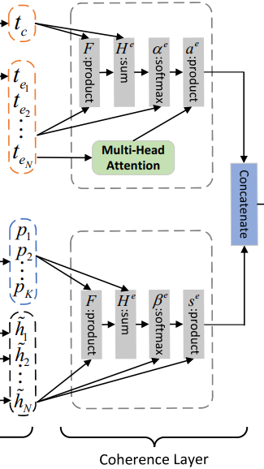









Coherence Layer
Generate the new topic representation of evidence based on the sentence-level
topic representation
The proximity matrix
The co-attention mechanism
compute the proximity matrix

Slide 7
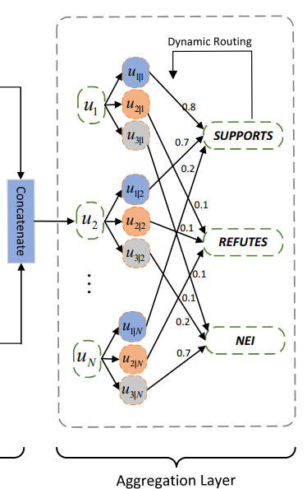





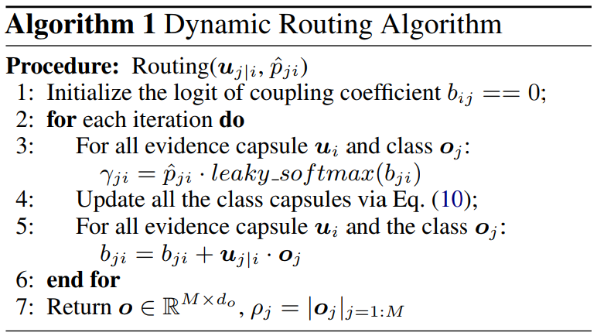
Aggregation Layer
The capsule network:
evidence capsule
class capsule

Slide 8
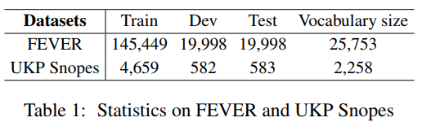
Experiments

Slide 9
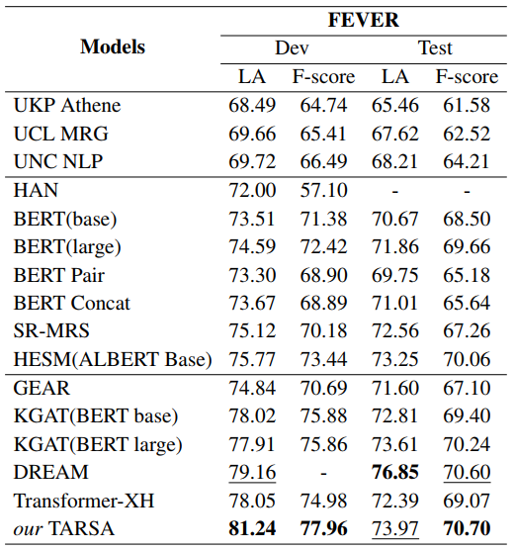
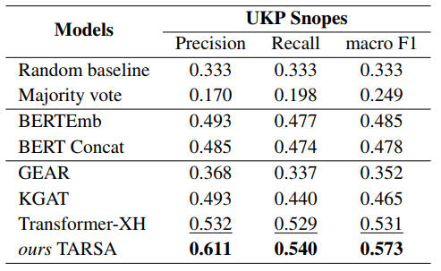
Experimental Results

Slide 10
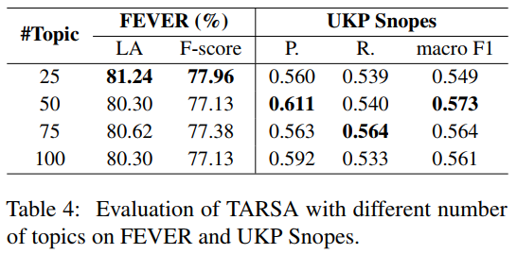
Effect of Topic Number

Slide 11
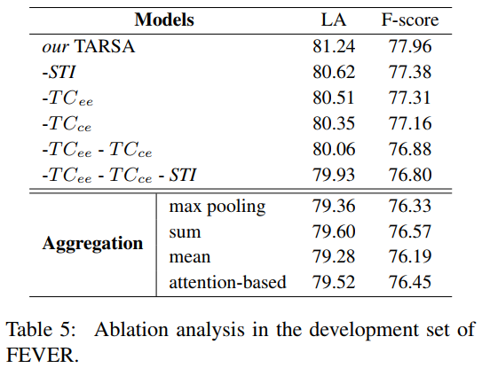
Ablation Study

Slide 12
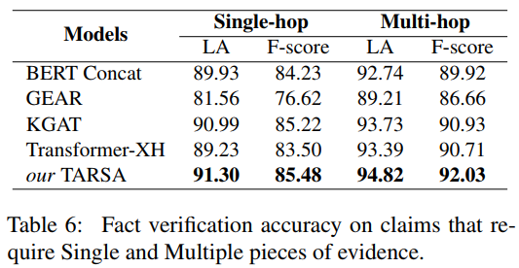
Performance on Different Scenarios

Slide 13
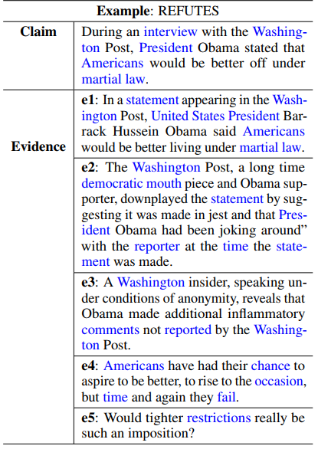
Case Study

